Slide 1


X

Slide 2

Background and Context
Taxis are an integral part of society in South Africa. They are critical to the movement of people and therefore operate in a way that is truly unique.
Vehicle telematics uses a combination of sensors, GPS systems, and vehicle diagnostics to collect and transmit vehicle data to a remote location.
Understanding the taxi driver is a complex task, and there are different types of styles and behaviours which they exemplify
There is true business value in identifying their key behavioural traits.

Slide 3


Welcome to the driver behavioural segmentation challenge!
Aims : To explore the vast potential of using telematics data to create comprehensive behavioural profiles of taxi drivers
The form of your final output is not prescriptive, and creativity is encouraged.
However, any categorisation of drivers must be interpretable
Considerations :
What features are relevant when trying to characterise driver behaviour?
How does the geographical location affect driver behaviour?
How does continuous time spent driving affect drivers?

Slide 4
Hints and Golden Nuggets
Please pay particular attention to dates and times when the driver is available (physically driving or active on the road)
Not all drivers have the same routes – consider the fact that different routes may have different challenges (e.g. traffic lights, congestion)
Pay particular attention to the claims data and how you can augment it to create powerful insights
You are allowed to take multiple roles/personas – it would be best to take one role (owner vs driver – to guide the solutions)
Try to emphasise specific actions taken from solutions you create. Here’s a few scenarios as examples:
if I am a taxi owner – I’d like to understand the likelihood of my taxi being involved in an accident given specific driver behaviour
if I were a taxi owner what characteristics would I use to make an informed decision around hiring a particular driver?
If were a driver “how can I use IoT data to improve my driving skills?”

Slide 5


Bonus Question (Not compulsory)
Sometimes it is possible for there to be more than one driver associated to a particular vehicle id. However, this is not always explicitly stated and it’s important to know when a particular vehicle is not being driven by the appropriate person. Can you identify any vehicles where there are multiple drivers?

Slide 6


Data
Dataset 1 :
The dataset contains a sample of 106 unique vehicles based in the Western Cape. The dataset has been partitioned by vehicle id and is available as 106 separate csv files. A separate data dictionary will be provided. This set is for the period January 2022 to April 2022.
Dataset 2 :
An additional and supplementary dataset including recorded insurance claims relating to accidents per vehicle is provided in the file named “claims_data.csv”. These claims are from the period of January 2021 to January 2023.
Note: Dates of individual claims have been purposefully omitted and will not be provided for compliance purposes.

Slide 7

Prizes
Prizes will be award to the top three teams selected at the finals. The top-placed women’s team will be eligible for additional prize. The prizes are as follows:
1st Place Team – R 22 000
2nd Place Team – R 12 000
3rd Place Team – R 6 000
Women’s Prize – R 6 000

Slide 8
Submission of your solutions
The Hackathon will launch virtually on Thursday 10 August (18:30), and close on Sunday 20 August (23:59)
Your submission should include the following:
A pdf document of no longer than one page explaining your solution.
A PowerPoint presentation describing the problem, your approach, and your solution. Finalists will be given an opportunity to polish their slides before the final presentations, without adding any content.
For those submitting any web apps or dashboards – make sure appropriate permissions are provided for judging.
A link to code. It can be a GitHub repository or a google drive link. For the latter, make sure that permissions are set so that we can download your code.
Make use of the submission form to submit your solution. The form will close on Sunday 20 August at 23:59.

Slide 9
Judging and Finals (Live-Event)
There will be two rounds of judging
In Round 1, solutions will be scored and approximately 6 finalists will be selected to present their solutions at an in-person event on Wednesday 23 August 2023 at the Stellenbosch Museum, 17:00.
Finalists will be emailed on the evening of Tuesday 22 August; however, all participants are invited to attend the in-person live event. Please make sure to arrive early to interact with the judges and please extend the invite to colleagues or friends that may be in the same field.
Industry professionals from Standard Bank CIB Digital and Mobalyz will be present at the finals, and this is a great networking opportunity.

Slide 10
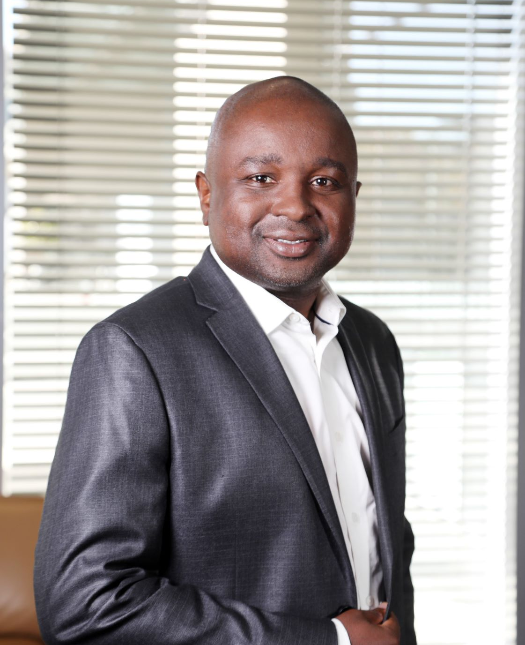

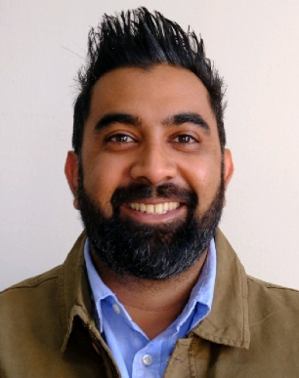
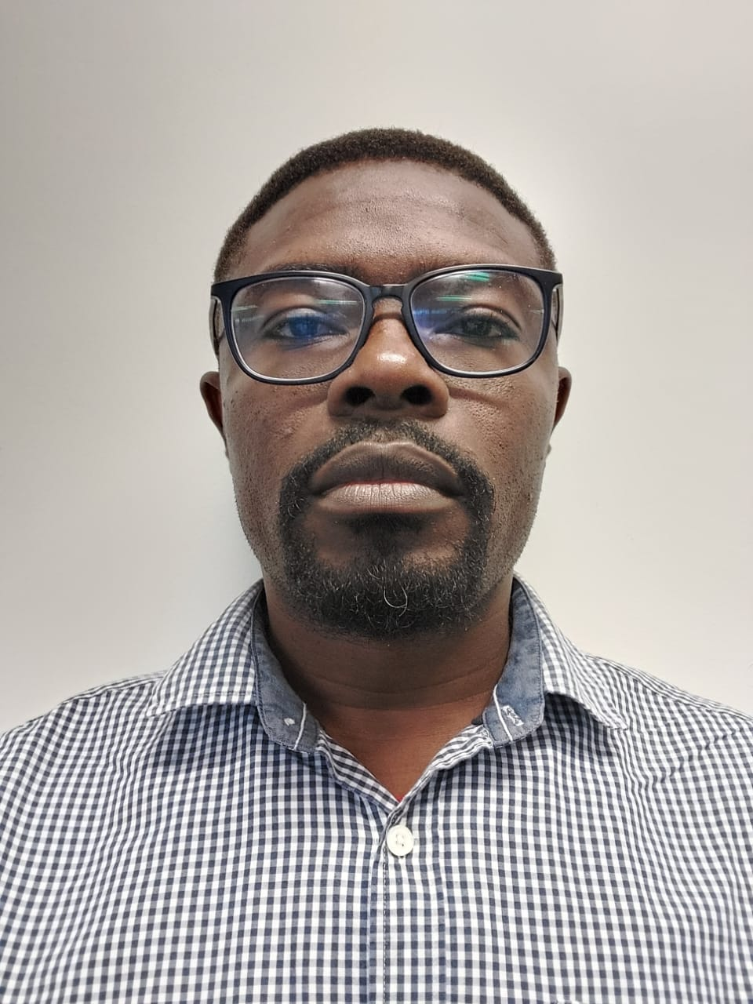
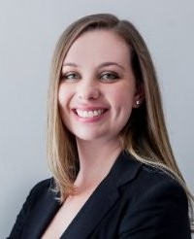
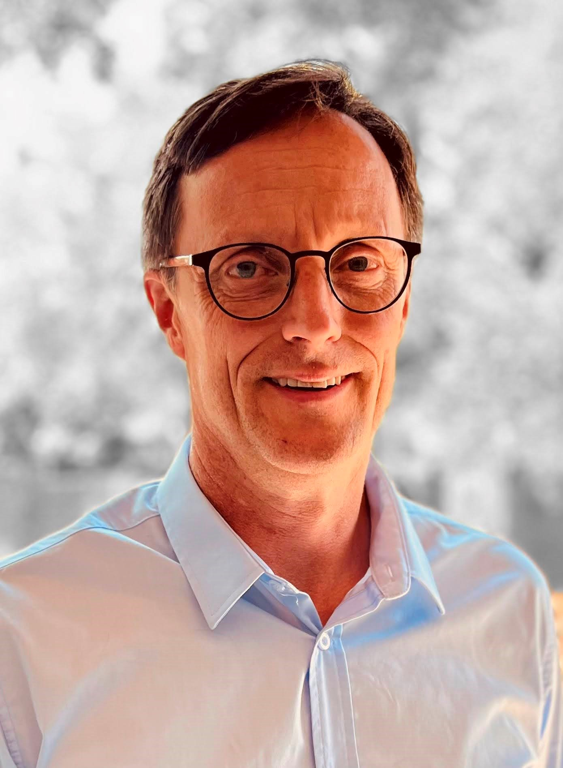

Our Dedicated Judges
John
Mukomberanwa
Pieta
Heyns
Martine
Burgess
C J
Naidoo
Dr Sunday
Oladejo
Claire-Davis
Reddy (PhD)
J G
Cowper
Head CIB Digital Insights
OneHub Product Owner, CIB Digital
Executive
Mobalyz
Head DevSecOps Mobalyz
Stellenbosch University
Data Product Specialist
MD Kiraz Partners (PTY) LTD
https://www.linkedin.com/in/john-mukomberanwa-3159211a/
https://www.linkedin.com/in/pietaheyns/
https://www.linkedin.com/in/martineburgess/
https://www.linkedin.com/in/cjnaidoo/
https://www.linkedin.com/in/claire-davis-reddy/
https://www.linkedin.com/in/jg-cowper-27b2623/

Slide 11
Good Luck !!
X

